Slide 1
Mobile Application Development
Lecture 9

Slide 2
State Management and Services in Angular
What is State? State is basically your data in the application.
Data that comes from the server, UI state like toggles (on / off), alerts and errors messages, User input, such as form submissions.
Managing state is hard when your application becomes complex. You need same data in multiple components. Now how are you going to make sure that its the same data?

Slide 3
State Management and Services in Angular
How are you going to update data in once place and make sure its updated everywhere?
In our previous class, we displayed the students list in studentslist page and then a single student information in student page/component. We used the same data but for that, we had to repeat same data in two different components. Not ideal. Becomes very hard to manage.
How do we handle this? We handle it in Angular via Services.

Slide 4
State Management Options
Angular provides (1) Services by default which help us with state management across our application.
Other frameworks use different philosphy, a global (2) Store, to manage their state.
There are open source libraries for these e.g NgRx (built for angular), Redux, MobX, Immer, VueX, Overmindjs etc
Some large angular applications use NgRx but it’s not really necessary as Services are enough.

Slide 5

Elon Musk. He has a Computer Science (Bachelors) degree. He is the co-creator of PayPal.
He is the first person with 3 companies worth $1Billion+ each.
Tesla Motors (Electric Cars)
SpaceX (Competitor of NASA) SolarCity (Renewable Energy Sources)

Slide 6
3 Entire different fields. And he has only a Computer Science Degree.
Takeaway here is, your degree shouldnot define you. If you have a Computer Science / Software Engineering degree, it doesnot means you can only do “this” but not “that”. False mentality. The only person who decides that is YOU.

Slide 7
Services
Angular provides Services by default which help us with state management across our application.
Angular services are singleton objects which get instantiated only once during the lifetime of an application.
They contain methods that maintain data throughout the life of an application, i.e. data does not get refreshed and is available all the time.

Slide 8
Services
The main objective of a service is to organize and share business logic, models, or data and functions with different components of an Angular application.
We might come across a situation where we need some code to be used everywhere on the page. Services help us achieve that. With services, we can access methods and properties across other components in the entire project.

Slide 9
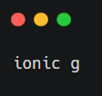
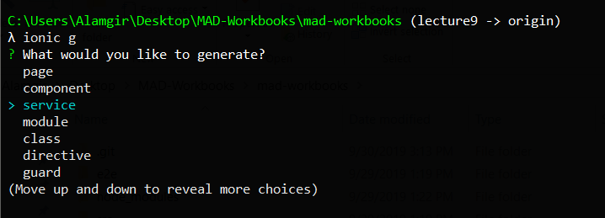
Services
Lets create a service

Slide 10
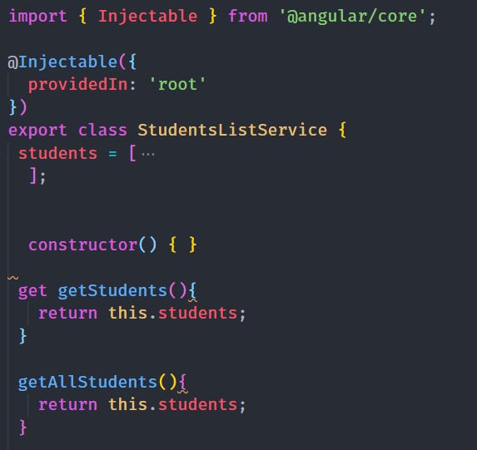
Services
A new Service file has been created. Students-list.service.ts
Now lets move that studentListing from component to service file.

Slide 11
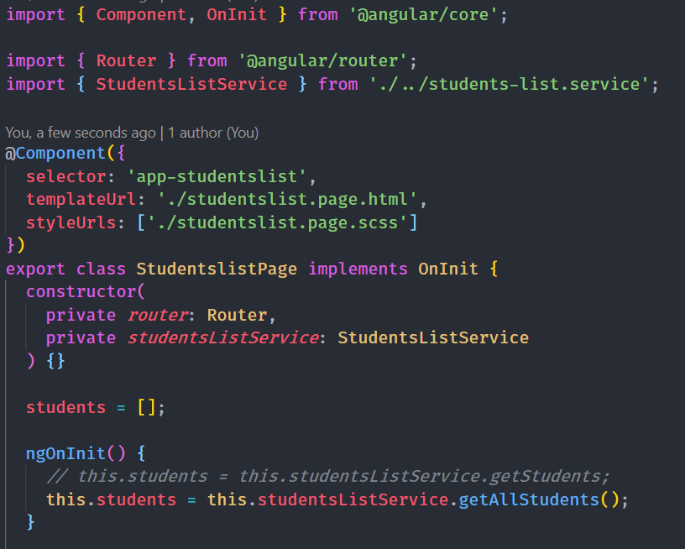
Services
Now lets use this service in component. First, we import it and inject it in constructor (Dependency Injection).

